Slide 1


Exploring integrated advice for outbreak response:
Lessons learned from an
Avian Influenza outbreak simulation in the Netherlands
Dr. Anja Schreijer, MD, PhD, MPH, Medical Director
Pandemic Disaster and Preparedness Center, Rotterdam,
The Netherlands
20th International Congress on Infectious Diseases 2024
5 December 2024
Notes:
ABSTRACT
Background:
The complexity of COVID-19 highlighted the need for involvement of social scientists alongside biomedical experts to develop advice. Future pandemics demand swift and effective collaboration across disciplines to address diverse consequences and priorities. The governance framework for outbreaks in the Netherlands requires different disciplines to provide advice separately to the government. We conducted an avian influenza outbreak simulation to explore development of integrated scientific advice in pandemics.
Methods:
We planned two simulation events on different phases of an outbreak on 17 April and 24 May 2024, in the Netherlands. During first simulation, the scenario depicted a variant of avian influenza spreading via pigs, triggering significant health implications for humans and animals. Scenario of the May simulation continues with human-to-human and cross-border transmission. On 17 April, 23 Dutch experts from biomedical, and social and economic sciences initially crafted their recommendations independently. Three interdisciplinary groups then converged, utilizing the WICID evidence-to-decision framework. Thematic analysis was conducted on notes of group and plenary discussions, and reflection and evaluation sessions.
Results:
Interdisciplinary discussions helped participants identify blind spots in disciplinary recommendations. Two interdisciplinary groups generated comprehensive recommendations, one required additional time for consensus. Agreement seemed to be swift in the animal husbandry but contentious regarding human measures, notably school closures. Various disciplines brought insights from respective sectors, informed by hard-earned lessons from past experiences, for example with outbreaks in animal husbandry, human health crises, and the repercussions of COVID-related school closures. Open dialogue and curiosity for alternate perspectives emerged as vital for integrated advice. Results of May will follow.
Conclusions
Simulations provide invaluable opportunities to prepare for national crisis responses, fostering understanding across disciplines, and further developing and refining integrated advisory approaches.

Slide 2
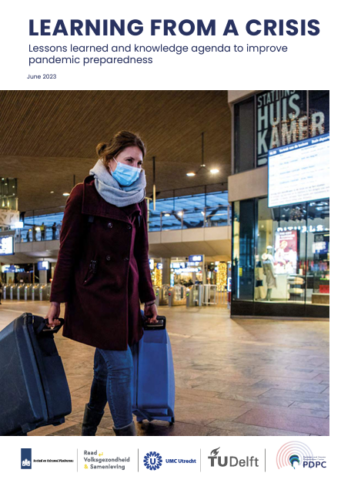
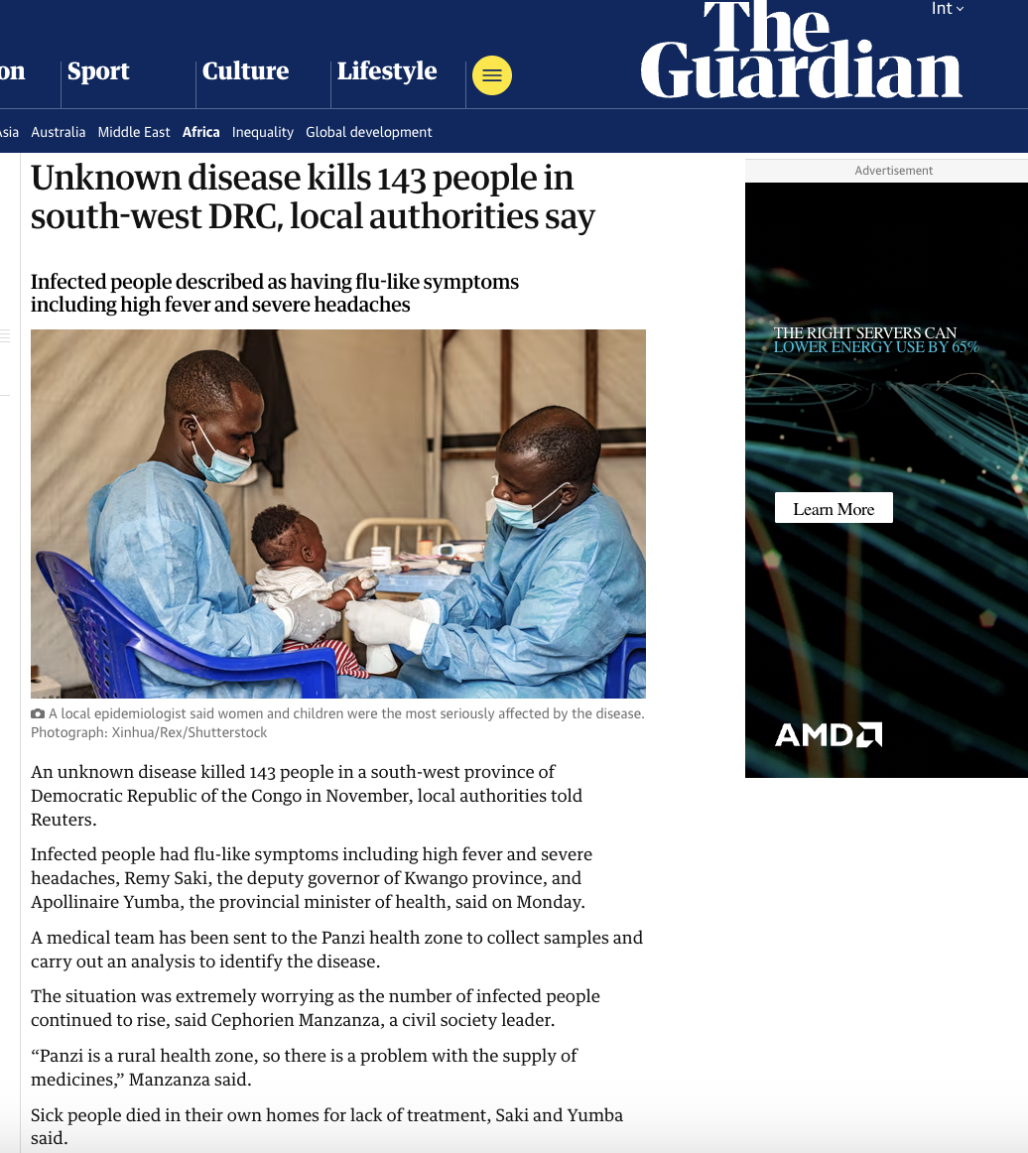
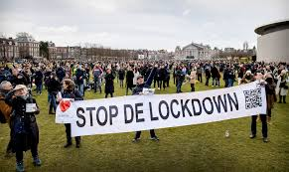
Background
COVID-19 highlighted the need for comprehensive, cross-disciplinary advice
Knowledge and know-how gaps in pandemic preparedness identified in COVID-19 evaluations
Ongoing pandemic threats, such as H5N1 influenza, Nipah, Disease X etc
Notes:
background

Slide 3
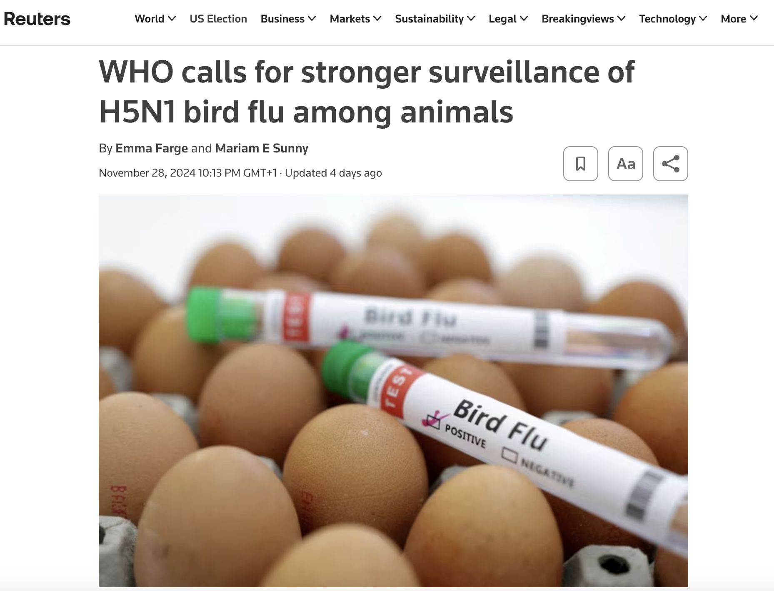
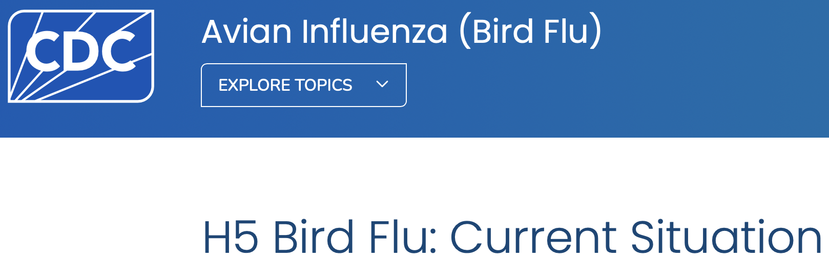
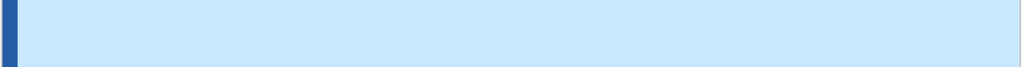
Research focus
Do separate biomedical and socio-economic advice have different characteristics?
Can conflicting characteristics be resolved in integrated advice?
What are the biomedical, social, economic and domain-overarching knowledge and know-how gaps in HPAI pandemic preparedness?
5 December 2024
58 Confirmed Total Reported Human Cases in the United States
Notes:
https://www.cdc.gov/media/releases/2024/p1122-h5n1-bird-flu.html#:~:text=Including%20this%20most%20recent%20case,the%20general%20public%20is%20low.

Slide 4
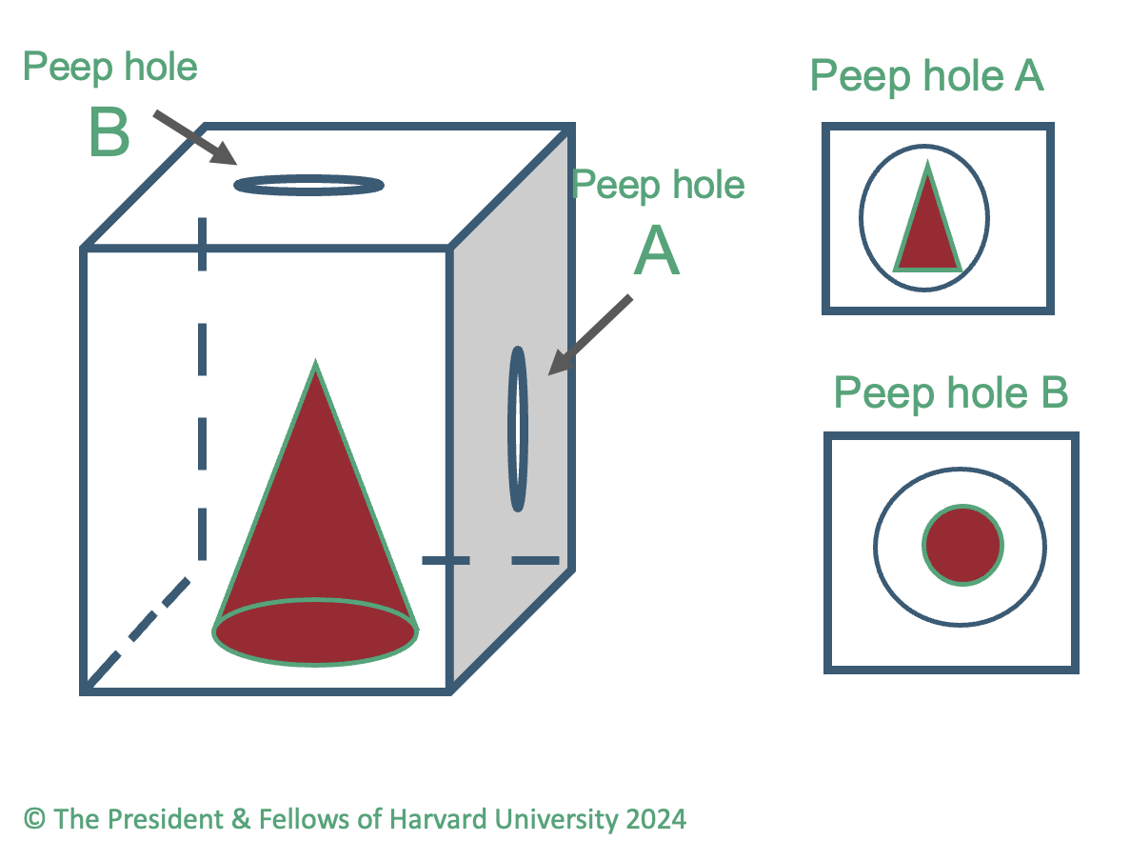
Simulation design & methods
Preparation:
Literature review (scientific and grey literature)
Interviews with 30+ experts from biomedical, social sciences and economic disciplines
Two simulation exercises
20-23 Dutch experts from biomedicine, social and behavioural sciences and economics
April 17: Large-scale outbreak of Avian Influenza among poultry and pig farms in the Netherlands with first human cases
May 24: Large-scale outbreak of Avian Influenza with human-to-human transmission (mainly those <30yrs affected), including transmission in schools
Notes:
Methods – foto invoegen

Slide 5
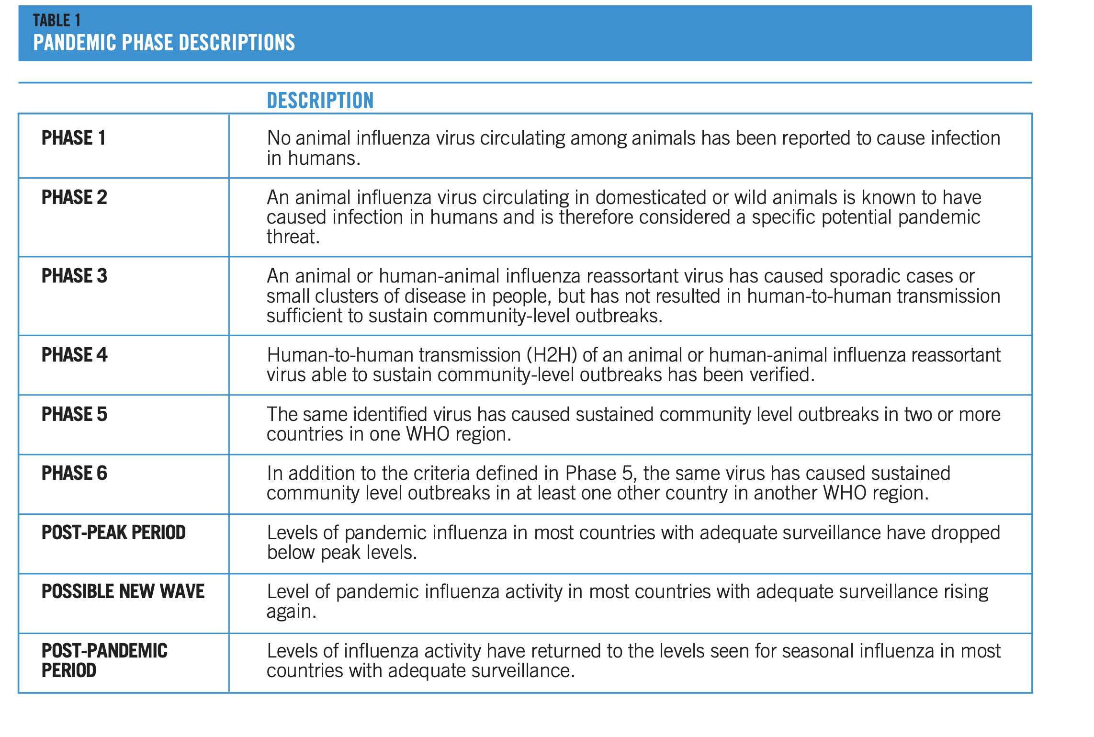
Source: WHO. Pandemic influenza preparedness and response : a WHO guidance document, 2009

Slide 6
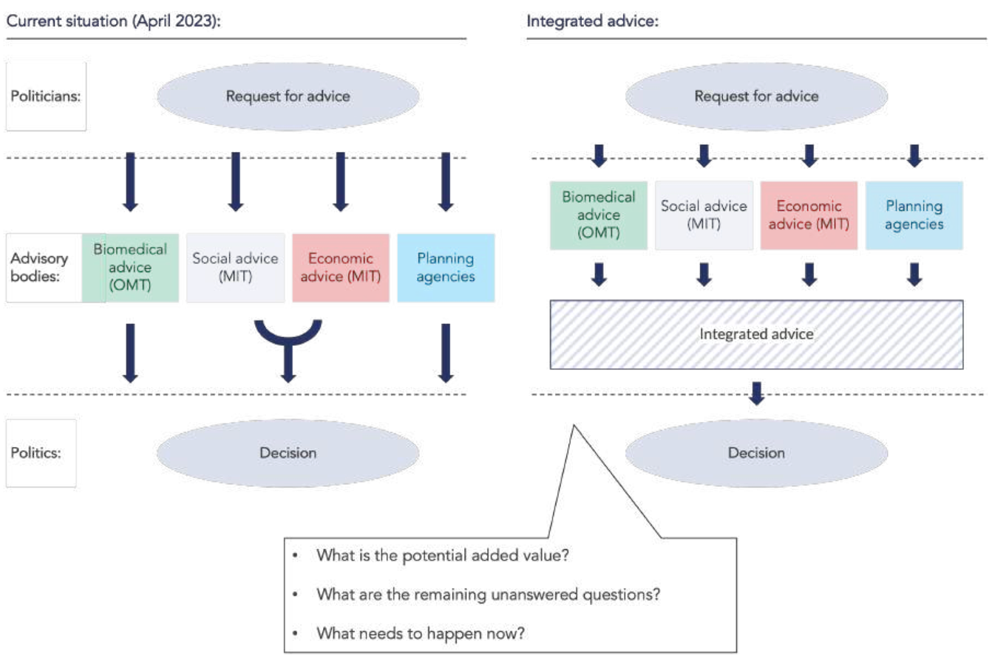
Simulation design & methods
Biomedical and socioeconomic groups first gave separate advice
  Aligned with the current Dutch advisory structure
Mixed groups subsequently had interdisciplinary deliberations
  Exploration of integrate structure

Slide 7
Results: different characteristics of in siloed advice
Biomedical team:
Prompt action needed to prevent large schale outbreak, including school closures
Implement biomedical guidelines asap
to prevent disruptions in the chain of care
Social-economic team:
Preserve social and economic
continuity and vitality
Social listening
Reluctant to implement PH measures

Slide 8
Key findings:
Interdisciplinary discussions help to recognize blind spots in risk perception, urgency, and unintended consequences of recommendations
Notes:
Findings schoolclosures voorbeeld

Slide 9
Knowledge and know-how gaps
Biomedical gaps:
  related to fundamental research, e.g. pyramid, severity parameters
  available knowledge that has not (yet) been incorporated into guidelines
Social gaps:
  related to the lack of available response guidelines, monitoring structures and infrastructures in case of a new outbreak.
Economic gaps:
  related most to (ethical) support issues
Cross-disciplinary gaps:
  gaps surfaced during the integrated session
  related to a lack of alignment of response structures or organization
What are biological properties/virulence factors of avian influenza which provide insight into the mutations that are the most threatening?
Can we design an infrastructure how to involve citizens -including underserved groups- in short term decision making?
Can we extend the limited data regarding the complex decision-making scenarios who, when and to which extend is eligible for (financial) support packages?
Can we optimize integrated advisory structures to act as prompt as possible in case of pandemic threats?

Slide 10

Implications for preparedness
Interdisciplinary advice should be further explored to determine when and where it is most effective
Invest in simulation exercises to facilitate mutual understanding
Develop over-arching structures, tools and approaches to optimize pandemic preparedness
-> NOW IS THE TIME!
Notes:
findings

Slide 11
Conclusions
Separate advice shows that interpretations of an emergency situation can differ, leading uncoordinated disciplinary advice
Interdisciplinary discussions are crucial to uncovering blind spots in disciplinary recommendations and overcoming differences in assessment and interpretation
Simulation exercises provide invaluable opportunities to prepare for national crisis responses, promote understanding across disciplines, and further develop and refine integrated approaches to advice.
Identifying knowledge and know-how gaps is key to pandemic preparedness so that decisive action can be taken in the event of an outbreak
Notes:
discussions are critical to uncovering blind spots in disciplinary recommendations and overcoming differences in assessment and interpretation.
-.
-Identifying gaps in knowledge and expertise is key to pandemic preparedness
so that decisive action can be taken in the event of an outbreak.

Slide 12
Acknowledgments
Sounding board:
  Prof. dr. M de Bruin
  Prof. dr. PA Dykstra
  Prof. dr. MPG Koopmans
  Prof. dr. DRM Timmermans
  Prof. dr. BJ ter Weel
Participants:
  Dr. RHM Bergervoet
  Prof. dr. M de Bruin
  Dr. LE Coffeng, MD
  Dr. J Conzales Rojas
  Dr. AMM van Deursen, MD
  Prof. dr. MLA Dückers
  Prof. dr. PA Dykstra
  Prof. Dr. RAM Fouchier
  Dr. R Hoefman
  Prof. dr.ir. MCM de Jong
  M Klok
  Prof. Dr.ir. B Kolen
  Prof. MPG Koopmans
  Dr. JAJW Kluytmans, MD
  MCM Loogman, MD
  M Petrignani, MD
  Prof. dr. SJHM van den Putte
  Prof. dr. CP Bleeker-Rovers, MD
  Dr. GJ Sips, MD
  MAH Spierenburg, DVM
  Prof. dr. DRM Timmermans
  dr. A Tostmann
  M van der Voet
  Prof. dr. BJ ter Weel
  Prof. dr. HFL Wertheim
  S Wiessenhaan
  M Wirken
  Prof. dr. JJ de Wit, DVM
Team PDPC:
  Bart Blokland, MSc
  Jeannette de Boer, MD
  Tomris Cesuroglu, MD PhD
  Valerie Eijrond, MSc
  Tim Florschütz, DVM
  Sheila Lopez
  Femke Overbosch, MD PhD
  Charlotte Waltz, PhD
  Charlotte van Zuthem

Slide 13


Do you have any questions?
For more information, please visit our website for updates on the topic:
https://convergence.nl/pandemic-disaster-preparedness-center/
&
https://convergence.nl/learning-from-a-crisis/

