Slide 1

Integral Scientific Advice for Outbreak Response:
Lessons learned from an Avian Influenza Simulation in the Netherlands
Dr. Charlotte Waltz, postdoctoral researcher
Pandemic & Disaster Preparedness Center, Erasmus University Rotterdam
European Scientific Conference on Applied Infectious Disease Epidemiology
21 November 2024
Notes:
ABSTRACT
Background:
The complexity of COVID-19 highlighted the need for involvement of social scientists alongside biomedical experts to develop advice. Future pandemics demand swift and effective collaboration across disciplines to address diverse consequences and priorities. The governance framework for outbreaks in the Netherlands requires different disciplines to provide advice separately to the government. We conducted an avian influenza outbreak simulation to explore development of integrated scientific advice in pandemics.
Methods:
We planned two simulation events on different phases of an outbreak on 17 April and 24 May 2024, in the Netherlands. During first simulation, the scenario depicted a variant of avian influenza spreading via pigs, triggering significant health implications for humans and animals. Scenario of the May simulation continues with human-to-human and cross-border transmission. On 17 April, 23 Dutch experts from biomedical, and social and economic sciences initially crafted their recommendations independently. Three interdisciplinary groups then converged, utilizing the WICID evidence-to-decision framework. Thematic analysis was conducted on notes of group and plenary discussions, and reflection and evaluation sessions.
Results:
Interdisciplinary discussions helped participants identify blind spots in disciplinary recommendations. Two interdisciplinary groups generated comprehensive recommendations, one required additional time for consensus. Agreement seemed to be swift in the animal husbandry but contentious regarding human measures, notably school closures. Various disciplines brought insights from respective sectors, informed by hard-earned lessons from past experiences, for example with outbreaks in animal husbandry, human health crises, and the repercussions of COVID-related school closures. Open dialogue and curiosity for alternate perspectives emerged as vital for integrated advice. Results of May will follow.
Conclusions
Simulations provide invaluable opportunities to prepare for national crisis responses, fostering understanding across disciplines, and further developing and refining integrated advisory approaches.

Slide 2
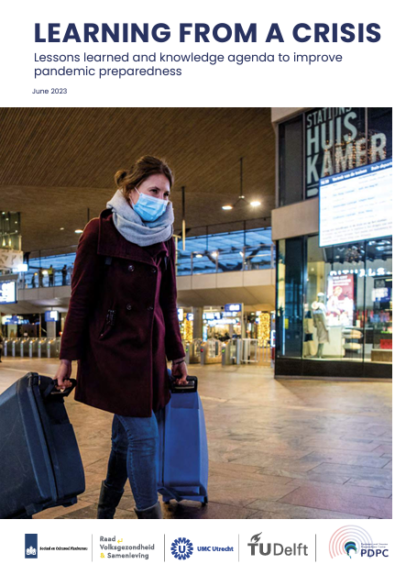
Pandemic and Disaster Preparedness Center
Research line Integrated Science for Policy
Notes:
QR code

Slide 3
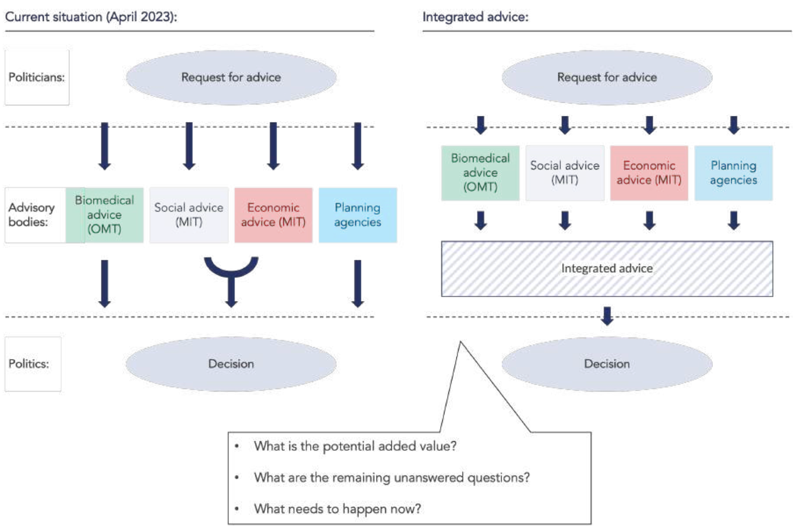
Study context & objectives
Background:
COVID-19 highlighted the need for comprehensive, cross-disciplinary advice
Effective pandemic responses should consider socio-economic impacts and public trust
Research focus:
How can knowledge from different disciplines on potential consequences of the virus and pandemic measures be integrated?
Evaluate the WHO-INTEGRATE-COVID-19 (WICID) framework as a facilitative tool
Notes:
Background // benoem ook knowledge gaps

Slide 4
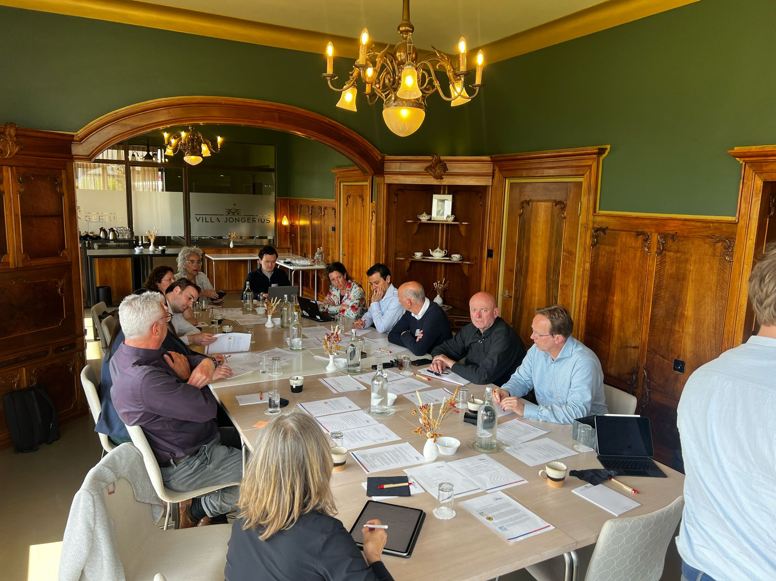
Simulation design & methods
Preparation:
Literature review (scientific and grey literature)
Interviews with 30+ experts from biomedical, social sciences and economic disciplines
Two simulation exercises with 20-23 Dutch experts from biomedicine, social and behavioural sciences and economics
April 17: Large-scale outbreak of Avian Influenza among poultry and pig farms in the Netherlands
  Moving from phase 2 to 4 of the WHO classification
May 24: Large-scale outbreak of Avian Influenza with human-to-human transmission (mainly those <30yrs affected), including transmission in schools
  Outbreak reached phase 5 of the WHO classification
Notes:
Methods – foto invoegen

Slide 5
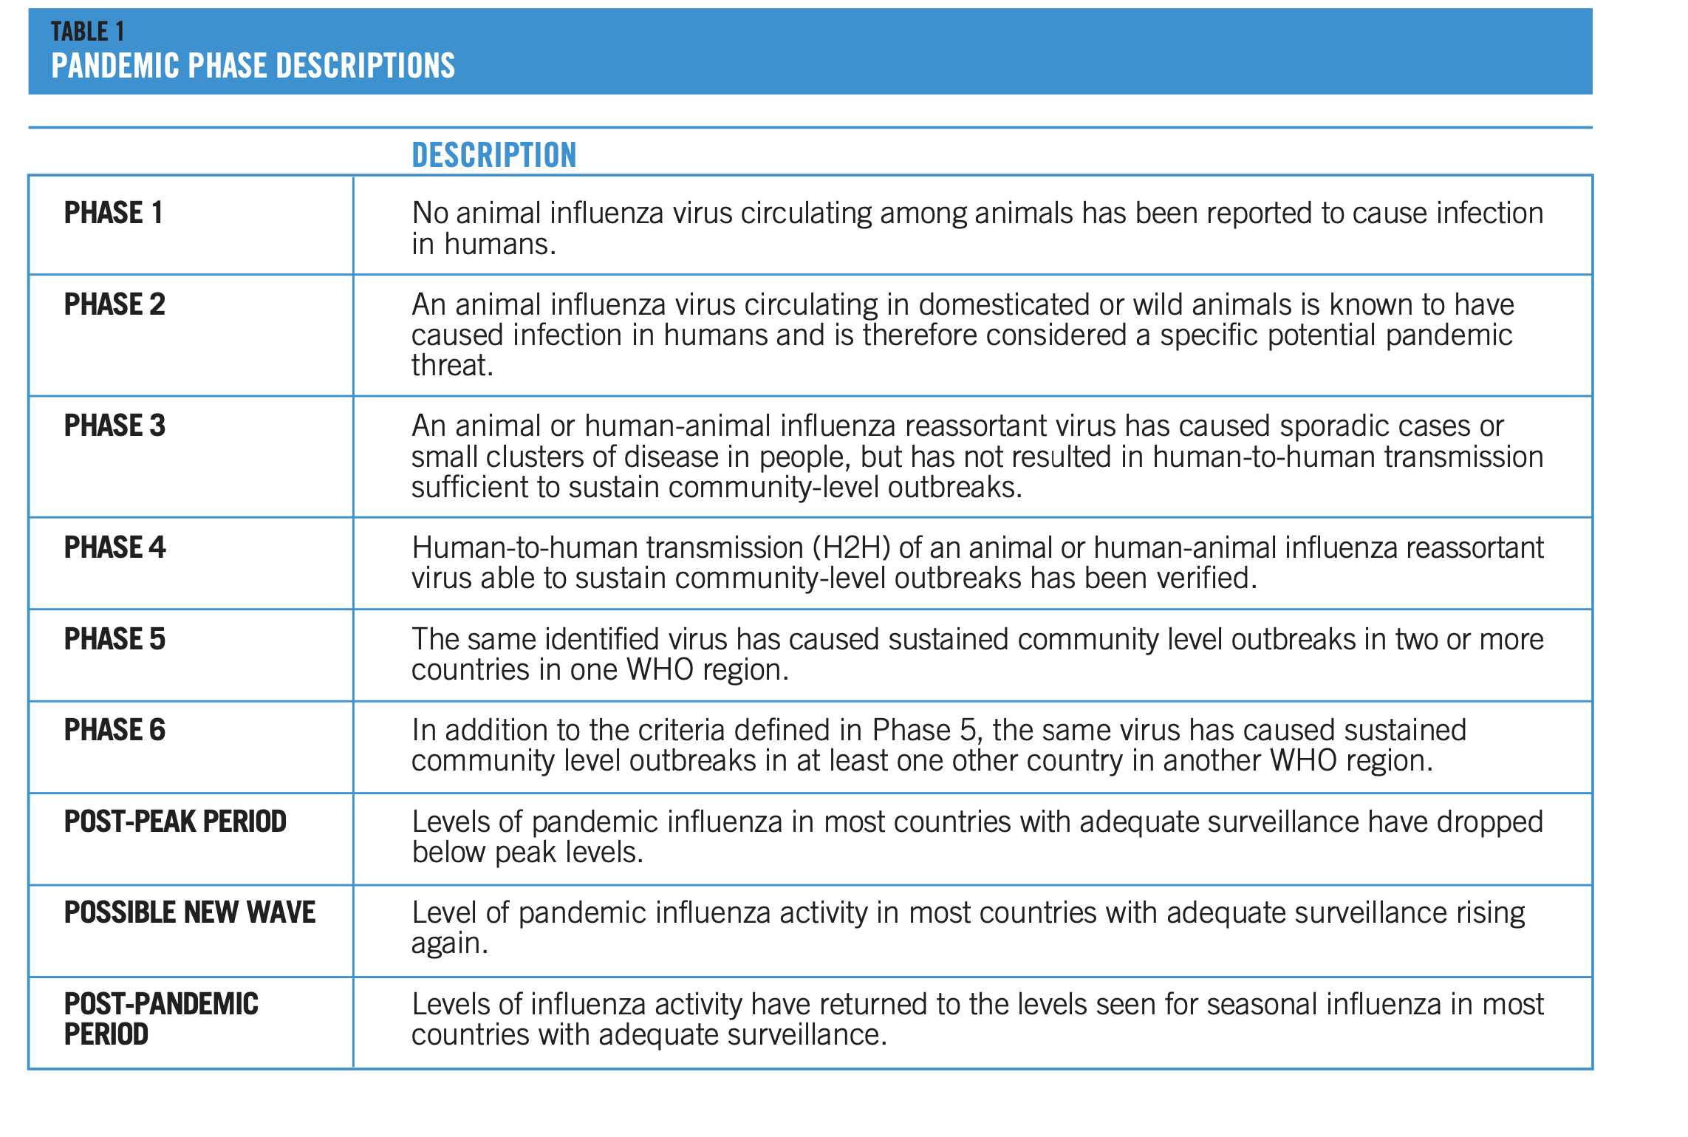

Slide 6
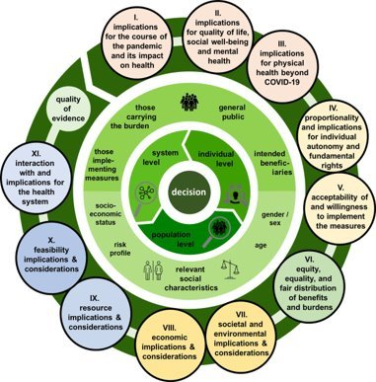
Simulation design & methods
Biomedical and socioeconomic groups first gave separate advice, aligned with the Dutch advisory structure
Interdisciplinary groups then utilised a modified version of the WICID Evidence-to-Decision framework (Stratil, Voss and Arnold 2020)

Slide 7
Key findings: Identifying blind spots in advice
Interdisciplinary discussions help to recognize blind spots in risk perception, urgency, and unintended consequences of recommendations
Notes:
findings

Slide 8
Mediating urgency and proportionality
For biomedical researchers: urgency in early phases of an outbreak is clear, this demands and justifies measures that included school closures
  Less attuned to the unintended consequences
For social and behavioural researchers, long-term impact of school closures was initially a bigger concern
  Severity and urgency of the outbreak and its potential direct consequences not immediately apparent
Participant R: “Direct action is required from the biomedical side, which leaves little room for contributions from social and behavioural sciences: this is where the friction lies.”

Slide 9

Implications for preparedness
The capacity to navigate, translate, and integrate diverse disciplinary knowledge is essential
Invest in developing a common language and frameworks
Research into the potential for adaptable, temporally responsive frameworks is needed
Develop structures, tools and approaches for social sciences in pandemic preparedness
Organise an information exchange structure between different disciplines
Notes:
findings

Slide 10
Conclusions
Integral advice offers enriched recommendations for pandemic policies, with clarification of underlying values and mitigation of unintended consequences.
Interdisciplinary discussions are crucial for pandemic advice to uncover blind spots in disciplinary recommendations.
Simulation exercises provide invaluable opportunities to prepare for national crisis responses, fostering understanding across disciplines, and further developing and refining integrated advisory approaches.

